Slide 1

BrightTV Viewership Analytics and Growth Recommendations
Insights and strategies to boost audience engagement
Notes:
AI-generated content may be incorrect. ---

Slide 2
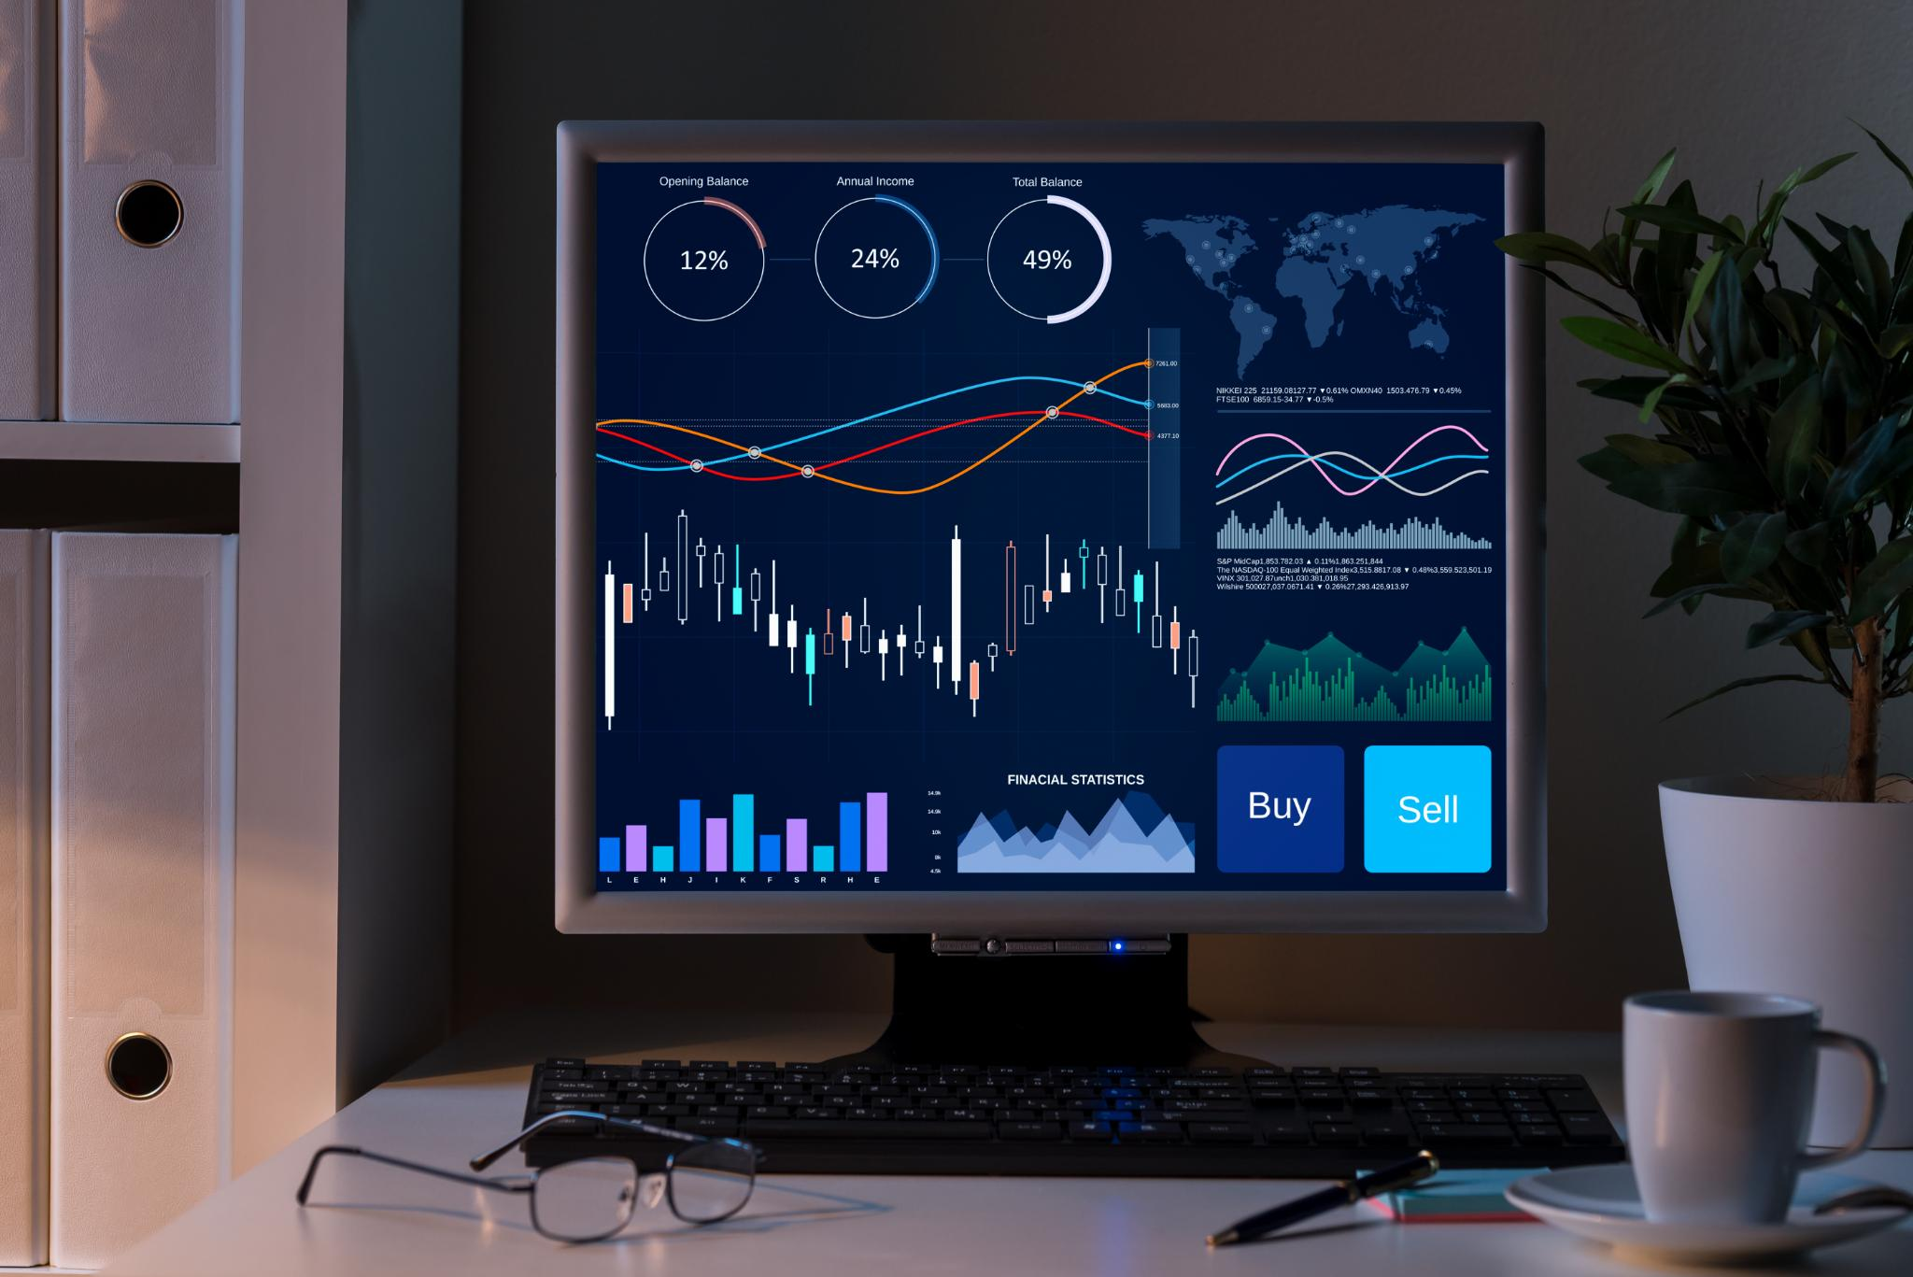
BrightTV Viewership Analytics Overview and CEO Growth Objective
Strategic Growth Objective
Bright TV aims to grow subscriptions in a competitive streaming market by enhancing user engagement and retention.
Viewership Data Analysis
Detailed session and demographic data reveal patterns in content consumption and viewer behavior.
Customer Value Management
CVM team uses analytics to design targeted initiatives increasing customer lifetime value and reducing churn.
Practical Recommendations
Insights lead to optimized scheduling, personalization, off-peak engagement, and tailored content offerings.
Notes:
--- This slide references information from the following file: https://firsttechgauteng-my.sharepoint.com/personal/lesegop_firsttech_co_za/Documents/Microsoft%20Copilot%20Chat%20Files/1774379193157_BrightTV_Case_Study.pdf This presentation focuses on a strategic viewership analytics case study conducted for BrightTV, with the primary objective of supporting the CEO’s goal to grow the company’s subscription base within the current financial year. BrightTV operates in a competitive digital television and streaming environment where subscriber acquisition and retention are strongly influenced by content relevance, viewing convenience, and perceived value. As customer acquisition costs rise across the industry, improving engagement among existing users becomes a critical lever for sustainable growth. The Customer Value Management (CVM) team plays a central role in this effort by using data to understand viewer behaviour and design targeted initiatives that increase lifetime value. The analysis uses detailed viewership session data combined with user profile information to identify patterns in how subscribers consume content. Each viewing session represents a discrete interaction between the user and the platform, allowing for granular analysis of content type, duration, timing, and frequency. By linking this behavioural data with demographic attributes such as age, gender, and province, the analysis moves beyond surface-level metrics and provides actionable insights into who is watching, what they are watching, and when they are most engaged. The ultimate purpose of this work is not only to describe existing trends, but to translate insights into practical recommendations that can directly improve the BrightTV station. These include optimising content scheduling, enhancing personalisation, increasing off-peak engagement, and strengthening content offerings that resonate with key audience segments. By aligning analytical insights with strategic decision-making, the presentation demonstrates how data can be used as a growth engine to drive higher engagement, reduce churn, and ultimately increase subscriptions in a measurable and sustainable way.

Slide 3
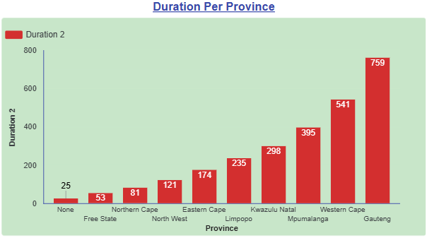
Viewership and User Profile Data Sources
Provincial Engagement Overview
Gauteng leads with the highest duration (759), showing significantly stronger engagement than all other provinces.
Top Performing Provinces
Western Cape (541) and Mpumalanga (395) follow Gauteng, forming a clear top‑three in viewership duration.
Mid‑Tier Provinces
KwaZulu‑Natal (298), Limpopo (235), and Eastern Cape (174) show moderate engagement and growth potential.
Lower Engagement Provinces
Free State, Northern Cape, and North-West record the lowest durations, indicating limited reach or adoption.
Notes:
--- This slide references information from the following file: https://firsttechgauteng-my.sharepoint.com/personal/lesegop_firsttech_co_za/_layouts/15/Doc.aspx?sourcedoc=%7B3EAC8B3A-4182-4B19-8DEA-56E890353B8C%7D&file=Viewership.xlsx&action=default&mobileredirect=true,https://firsttechgauteng-my.sharepoint.com/personal/lesegop_firsttech_co_za/_layouts/15/Doc.aspx?sourcedoc=%7BDB0C8EC0-EF20-44AA-BFF1-D48F437DD4B8%7D&file=User%20Profiles.xlsx&action=default&mobileredirect=true The analysis is built on two primary data sources provided by BrightTV: the viewership dataset and the user profiles dataset. The viewership data captures individual viewing sessions, with each record representing a single instance of a subscriber consuming content on the platform. Key fields include the user identifier, channel or content name, session start time, and viewing duration. This session-level structure enables detailed analysis of consumption intensity, frequency, and timing across the subscriber base. The user profiles dataset complements the behavioural data by providing demographic and contextual information about subscribers. Attributes such as age, gender, and province allow the analysis to segment users and identify differences in viewing behaviour across population groups. When combined with viewership data, these profiles enable BrightTV to move from generic insights to targeted strategies, such as tailoring content offerings to specific age groups or regional preferences. An important consideration in the data preparation process is the handling of time and date fields. All timestamps in the source data are supplied in Coordinated Universal Time (UTC) and must be converted to South African local time to ensure accurate analysis of daily and hourly viewing patterns. Proper data cleaning and validation steps, including null checks and format verification, are essential to maintain data integrity. By ensuring that the datasets are accurately prepared and correctly joined, the analysis provides a reliable foundation for generating insights and recommendations that can confidently inform business decisions.

Slide 4
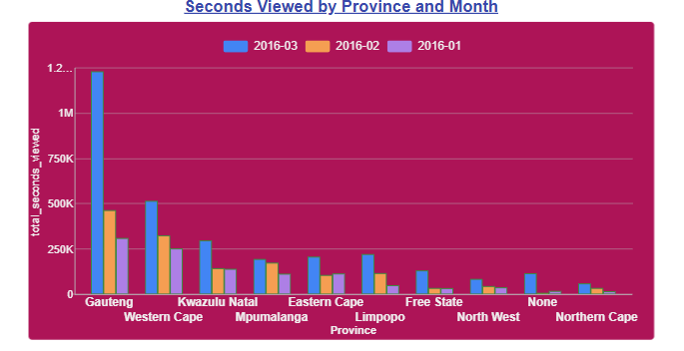
Key User Behaviour and Viewing Patterns
Live Events Drive Engagement
Subscribers show strong engagement with live events and popular entertainment, boosting viewing duration and repeat sessions.
Short, Frequent Viewing Sessions
Users prefer short, frequent viewing sessions aligning with modern digital consumption habits and on-the-go content access.
Segmented User Engagement
Engagement varies across user segments, with some demographics showing higher activity and longer viewing times for targeted strategies.
Notes:
Analysis of user and usage trends reveals several important patterns in how subscribers interact with the BrightTV platform. One notable trend is the strong engagement with live events and popular entertainment content, which consistently attract higher viewing durations and repeat sessions. This suggests that real-time or event-driven programming plays a significant role in driving user engagement and should be considered a strategic asset for the platform. The session-based nature of the data also highlights that many users engage in short, frequent viewing sessions rather than long, continuous viewing periods. This behaviour aligns with modern digital consumption habits, where users dip in and out of content throughout the day. Understanding this pattern is essential for optimising content formats, such as offering highlights, recaps, or short-form programming that fits naturally into these consumption windows. Additionally, the analysis indicates variation in engagement levels across different user segments. Certain demographic groups exhibit higher overall activity and longer average viewing times, suggesting opportunities for targeted retention strategies. By identifying which users are most engaged and what content drives that engagement, BrightTV can prioritise investments in programming and features that reinforce positive viewing habits and encourage continued platform usage.

Slide 5
Peak and Low Viewership Periods
Evening and Night Peaks
Viewership peaks during evening and night hours when users prefer longer and live content.
Midday and Afternoon Lows
Midday and early afternoon show lower consumption, offering opportunities for targeted engagement.
Strategic Scheduling
Aligning content and promotions with viewing rhythms maximizes platform performance and engagement.
Notes:
Time-based analysis shows clear patterns in when BrightTV subscribers are most and least active. Viewership peaks during the evening and night hours, reflecting typical post-work and leisure-time consumption behaviour. During these periods, users are more likely to engage with longer content and live programming, making them ideal windows for premier content and high-impact scheduling. In contrast, midday and early afternoon periods show significantly lower consumption levels. While this may partly reflect work and school commitments, it also represents an opportunity for BrightTV to stimulate additional engagement through targeted strategies. For example, promoting short-form content, replays, or background viewing options during these quieter periods could help increase overall platform utilisation. Understanding these temporal dynamics is critical for improving the TV station’s performance. By aligning content scheduling and promotions with natural viewing rhythms, BrightTV can maximise the return on its content investments. Furthermore, identifying underutilised time slots enables the CVM team to design interventions specifically aimed at smoothing demand across the day, rather than relying solely on already-strong peak periods.

Slide 6
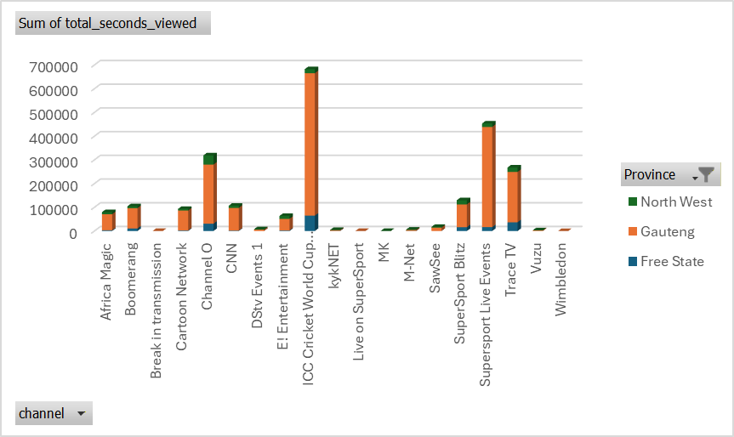
Inland Provinces Viewership Insights
Viewing Time Impact
Time of day significantly affects subscriber viewing behavior, with distinct patterns during peak and off-peak hours.
Content Type Influence
Live events, sports, and entertainment content drive higher engagement than generic programming on BrightTV.
Demographic Preferences
Viewer age and geographic location shape content preferences and viewing schedules, requiring personalized strategies.
Data-Driven Decisions
Utilizing data analytics enables BrightTV to optimize content scheduling and promotion to boost engagement and subscriptions.
Notes:
Several key factors influence how and when subscribers consume content on BrightTV. Time of day is a primary driver, with clear differences in viewing behaviour between peak and off-peak periods. Content type is another major factor, as live events, sports, and entertainment programming tend to generate higher engagement than generic or filler content. Demographic characteristics also play an important role in shaping consumption patterns. Age groups differ in their preferred content types and viewing times, while geographic factors such as province may influence access patterns and content relevance. These differences highlight the importance of moving away from a one-size-fits-all programming strategy toward a more segmented and personalised approach. By understanding the interaction between these factors, BrightTV can make more informed decisions about content acquisition, scheduling, and promotion. Rather than relying on intuition, the platform can use data-driven insights to prioritise initiatives that align with actual viewer preferences and behaviours, ultimately improving engagement and supporting subscription growth.

Slide 7
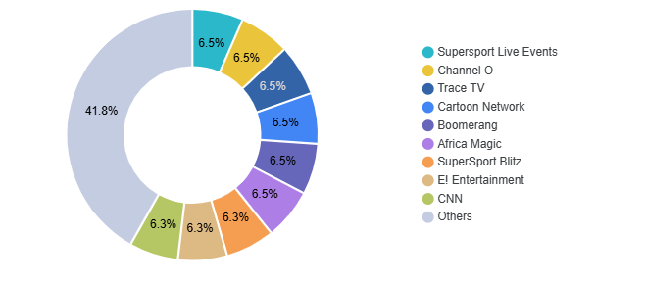
Channel Distribution Overview
The “Others” category dominates the chart, accounting for just over 40% of total records, indicating a large spread across smaller or less frequent channels.
All named channels contribute similar, smaller shares (around 6–7% each), suggesting no single channel dominates by record count.
Overall, the distribution reflects diverse and fragmented content consumption, rather than reliance on a few leading channels.
Notes:
Implementing the recommended strategies is expected to deliver measurable business impact for BrightTV. Improved content scheduling and personalisation should lead to higher average viewing durations and increased session frequency, indicating stronger engagement. As users find more relevant and timely content, their overall satisfaction with the platform is likely to increase. Higher engagement typically translates into improved retention, as subscribers who regularly find value in the service are less likely to churn. By addressing both peak and off-peak usage, BrightTV can create a more balanced and resilient engagement profile, reducing reliance on a narrow set of high-performing periods or content types. Over time, these improvements support the CEO’s subscription growth objective by strengthening the core value proposition of the BrightTV station. Engaged and satisfied users are more likely to remain subscribers, recommend the service to others, and respond positively to upsell or cross-sell initiatives, creating a virtuous cycle of growth.

Slide 8
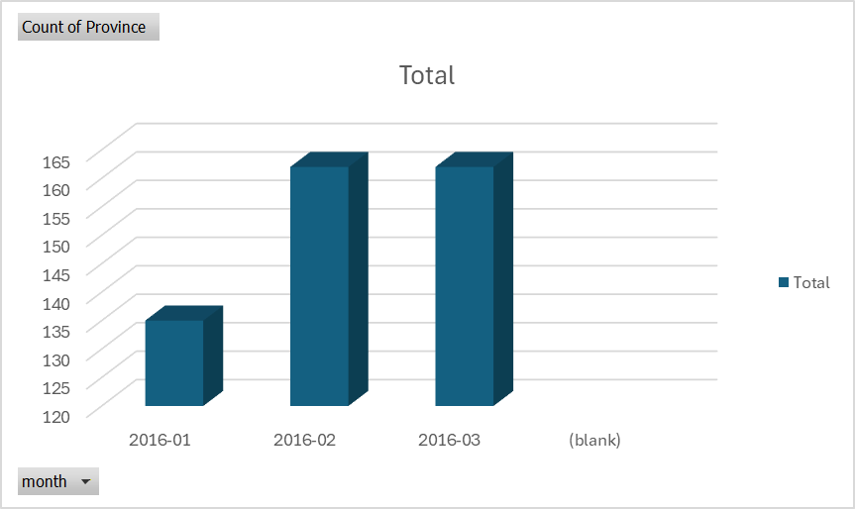
End‑to‑End Approach: From Data to Recommendations
Step 1: Data Collection & Preparation
Consolidated viewership data (total seconds viewed) across channels and months.
Ensured data quality by removing anomalies (e.g. negative viewing time).
Created a clean, analysis‑ready dataset for consistent reporting.
Step 2: Overall Viewership Analysis
Analyzed total viewing time to understand overall consumption levels.
Identified which channels contribute most to platform engagement.
Assessed how engagement is distributed across the platform.
Step 3: Channel Performance Assessment
Compared channels based on their share of total seconds viewed.
Identified top-performing channels (e.g. Africa Magic) as key engagement drivers.
Identified lower-performing channels with growth potential.
Step 4: Month‑to‑Month Trend Analysis
Reviewed viewership by month to identify peaks and declines.
Observed stronger performance in early months, followed by tapering.
Looked for consistency rather than one‑off spikes.
Step 5: Audience Consumption Behavior Review
Analyzed viewing behavior patterns to understand how and when users consume content.
Identified opportunities to influence engagement through timing and content placement.
Notes:
Beyond improving engagement among existing users, BrightTV can implement targeted initiatives to grow its overall subscription base. One effective approach is offering trial access to premium or live content, allowing potential subscribers to experience the value of the platform before committing financially. This can be particularly effective when combined with time-limited promotions during major events. Another initiative involves creating bundled offerings tailored to specific segments, such as family packages or youth-focused plans. These bundles can increase perceived value while encouraging multiple household members to engage with the platform. Targeted marketing campaigns, informed by analytics, can further support acquisition by focusing resources on segments most likely to convert. By aligning growth initiatives with observed usage patterns and preferences, BrightTV can increase the efficiency of its marketing spend and improve conversion rates. These initiatives work best when integrated with ongoing engagement strategies, ensuring that new subscribers quickly find content that meets their expectations and encourages continued usage.

Slide 9
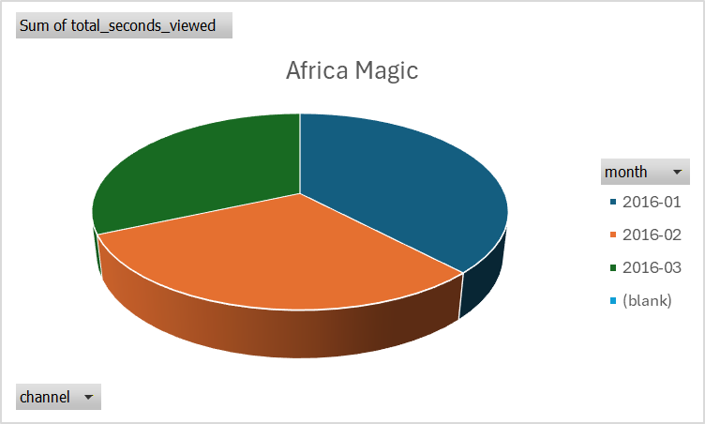
Cross‑Board Strategic Recommendations for Bright TV
1. Shift from Month‑Driven to Momentum‑Driven Programming
Plan programming and promotions in rolling cycles, not isolated monthly bursts.
Introduce mid‑cycle content refreshes, teasers, or featured collections.
2. Use Top Channels as Traffic Drivers for the Platform
Leverage high‑performing channels (like Africa Magic) to cross-promote lesser‑viewed channels.
Introduce “If you enjoyed this, try…” placements.
3. Align Content Strategy to Time‑of‑Day Behavior
Position short, repeatable or lighter content during daytime hours.
Reserve premium and long‑form content for peak evening periods.
4. Proactive Drop‑Off Prevention
Monitor month‑over‑month declines as early warning signals.
Trigger interventions such as featured content, push notifications, or thematic weeks when engagement dips.
5. Make Performance Tracking Actionable
Move beyond reporting “what happened” to tracking what is changing.
Use dashboards to flag declining channels, months, or time slots automatically.
Notes:
In summary, this case study demonstrates how viewership analytics can be used to directly support BrightTV’s strategic objective of subscription growth. By combining session-level viewing data with user profile information, the analysis provides a detailed understanding of who the viewers are, how they consume content, and what drives their engagement. The insights highlight both strengths, such as strong peak-time engagement with live and entertainment content, and opportunities, including underutilised off-peak periods. Importantly, the presentation translates these findings into concrete recommendations aimed at improving the TV station’s performance through better scheduling, personalisation, and targeted growth initiatives. By aligning analytics-driven insights with executive priorities and operational execution, BrightTV is well positioned to enhance viewer experience, improve retention, and achieve sustainable subscription growth. The recommended next steps ensure that these benefits can be realised in practice and maintained over time.

